Slide 1
Physiological Noise Correction for fMRI
- an Introduction to the PhysIO Toolbox
Lars Kasper
April 30th , 2014

Slide 2
The PhysIO Toolbox
Developed at the Translational Neuromodeling Unit (TNU) since 2008
Lead programmer: Lars Kasper (TNU)
Contributors: Jakob Heinzle (TNU), Steffen Bollmann (KiSpi Zurich)
Part of the TNU «TAPAS» software suite
Used at the TNU, in Zurich and beyond by ~30 researchers
Current version:
http://www.translationalneuromodeling.org/tapas/
Documentation & Example Data:
http://www.translationalneuromodeling.org/software/documentation/
http://www.translationalneuromodeling.org/software/tapas-data/

Slide 3

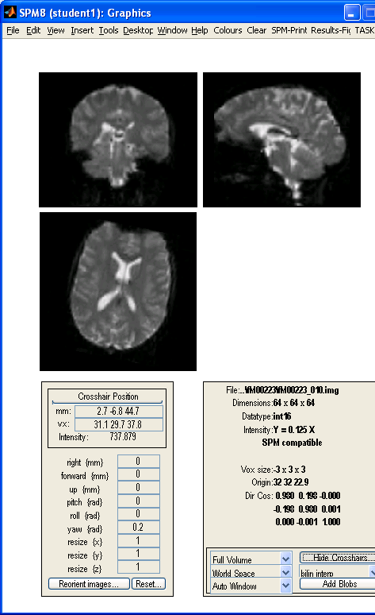
fMRI = Acquiring Movies
…of three-dimensional Blood Oxygen-Level Dependent (BOLD) contrast images
z
y
x
Run/Session: Time Series of Images
Task
Task
No Task
…
scan 1
time
scan N
Notes:
slice 21…after warping…slice 34 before

Slide 4
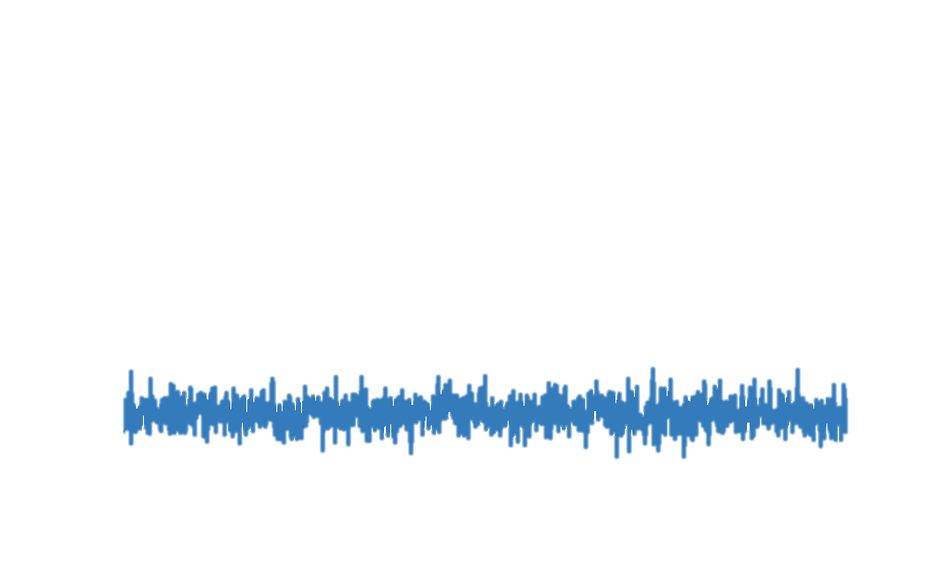
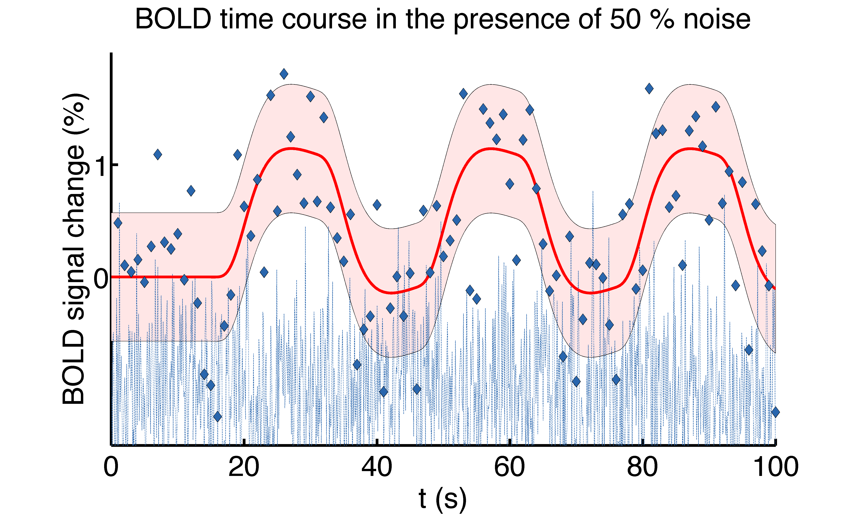
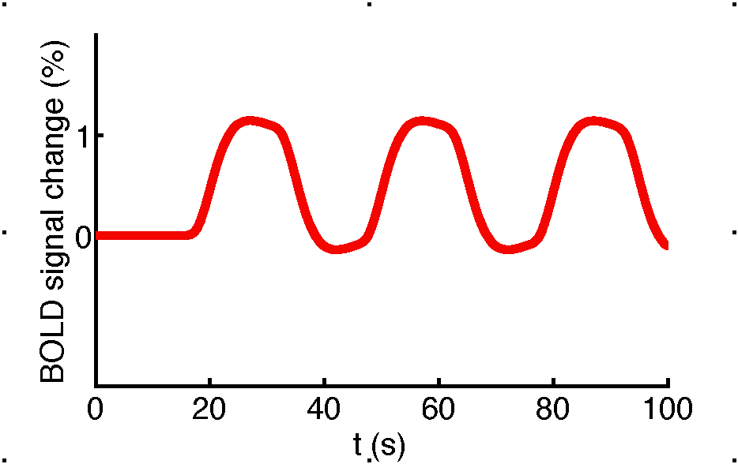
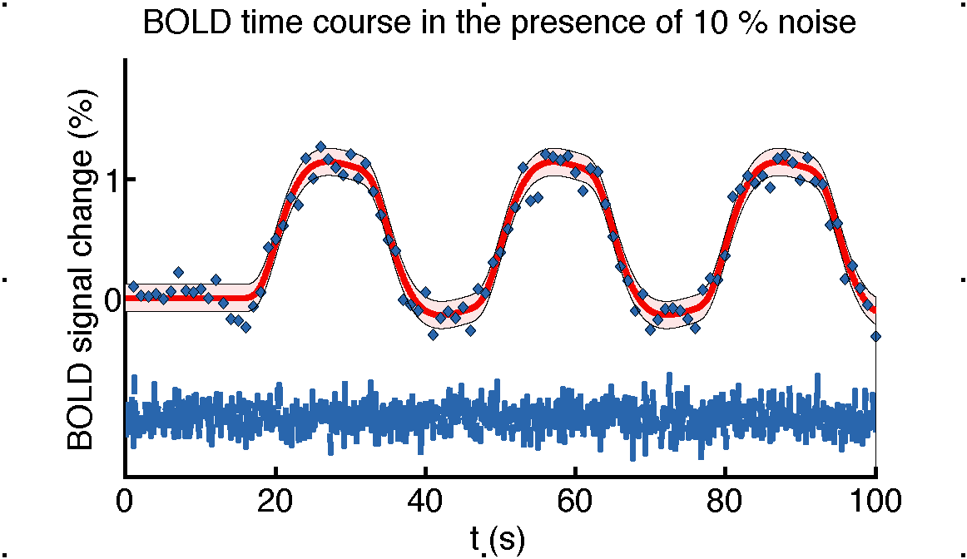
fMRI = Acquiring Movies
The Localized Time-series is the Fundamental Information Unit of fMRI
Signal: Fluctuation through Blood oxygen level dependent (BOLD) contrast
Noise: All other fluctuations
Run/Session: Time Series of Images
…
scan 1
time
scan N
Notes:
slice 21…after warping…slice 34 before

Slide 5


Noise Categories & Reduction
Thermal Noise
temporally uncorrelated
reduced SNR ➔ risk of false negatives
Remedy: Spatial Smoothing
Noise: All other fluctuations
“Structured” Noise
temporally correlated
reduced SNR ➔ risk of false negatives
correlated with task ➔risk of false positives
Remedy: Noise Modelling (e.g. GLM)
Inference = Signal-To-Noise
Notes:
slice 21…after warping…slice 34 before

Slide 6
The Problem: Physiological Noise
Cardiac effects
Respiratory effects

Slide 7
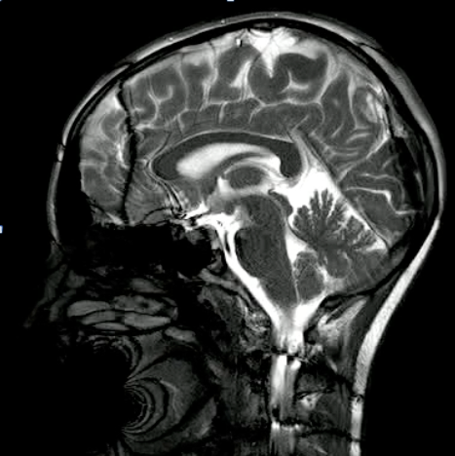
The Problem: Physiological Noise
Cardiac effects
Systole:
Blood pumped into brain, vessel volume increases: pulsatile vessels
CSF pushed down: pulsatile CSF
Diastole:
Vessel volume decreases
CSF flows back into “void” brain volume
A Cardiac Cycle in the Brain

Slide 8
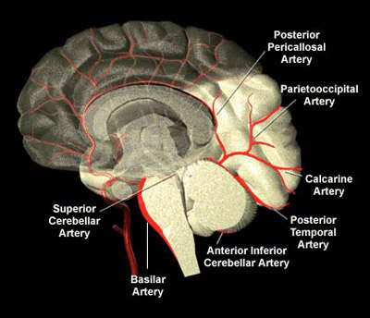
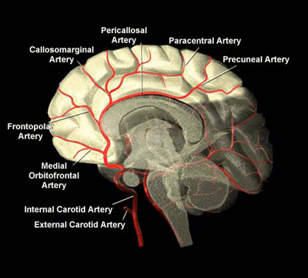
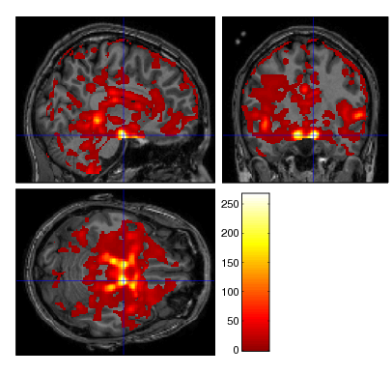
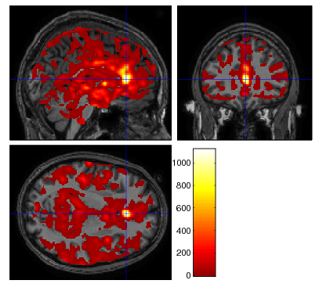
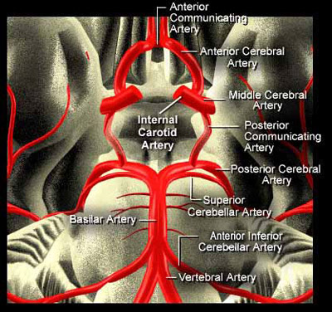
The Problem: Physiological Noise
Cardiac effects
Vessel Anatomy
Locations
of Fluctuations

Slide 9
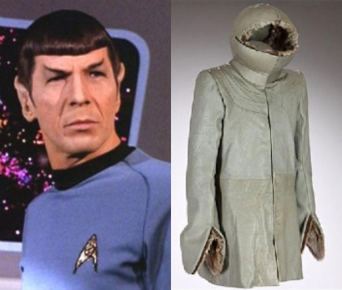
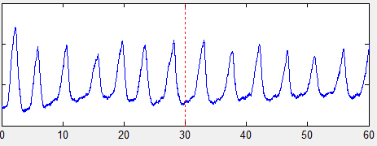
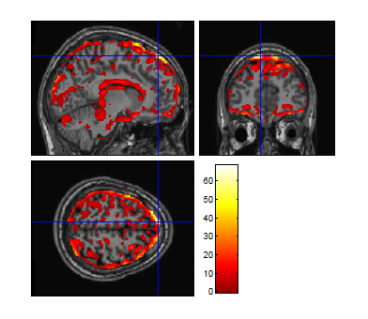
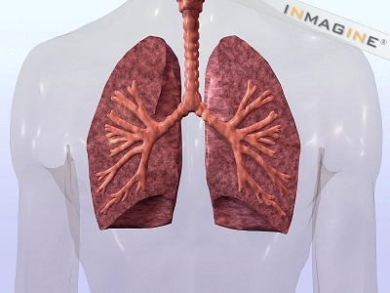
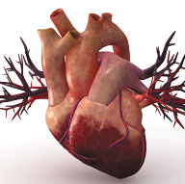
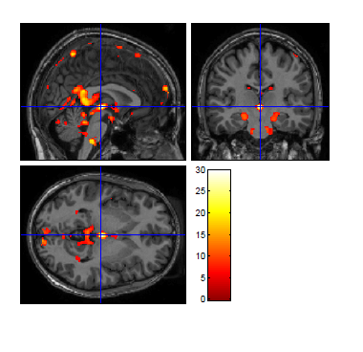
The Problem: Physiological Noise
Cardiac effects
Respiratory effects
Chest (&head) moves with respiratory cycle
Changes in lung volume change encoding magnetic field for MR
Geometric distortion/scaling
Respiratory-sinus arrythmia
Heart beats faster during inhalation

Slide 10
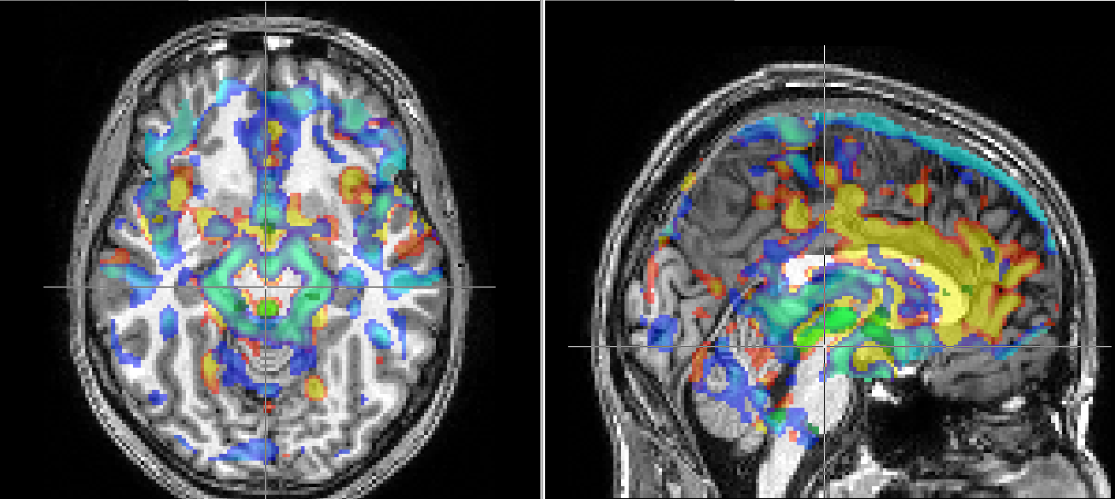
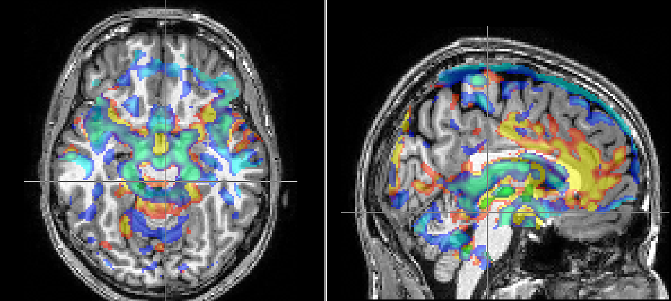
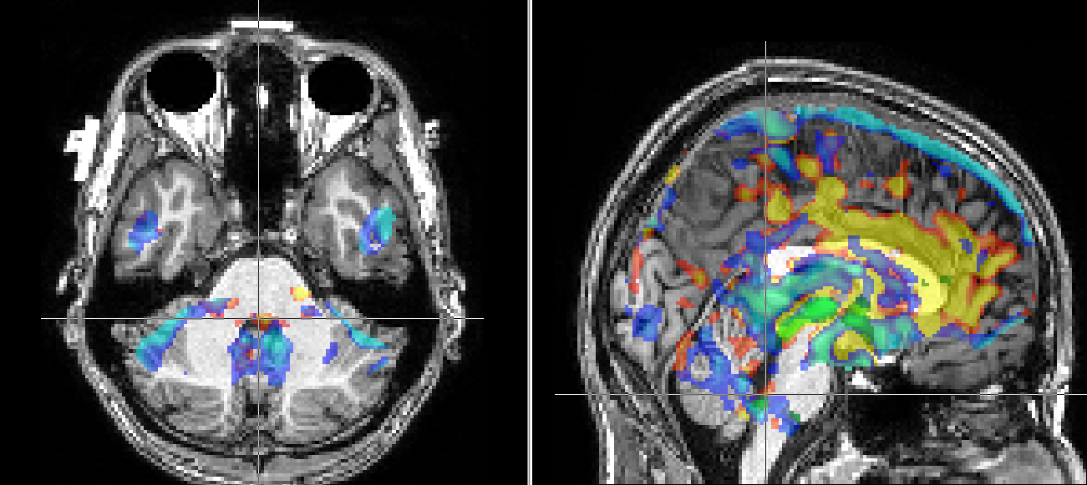
Relevance for Neuromodulation
VTA (DA)
Raphe Nuclei (5-HT)
Locus coeruleus (NA)

Slide 11
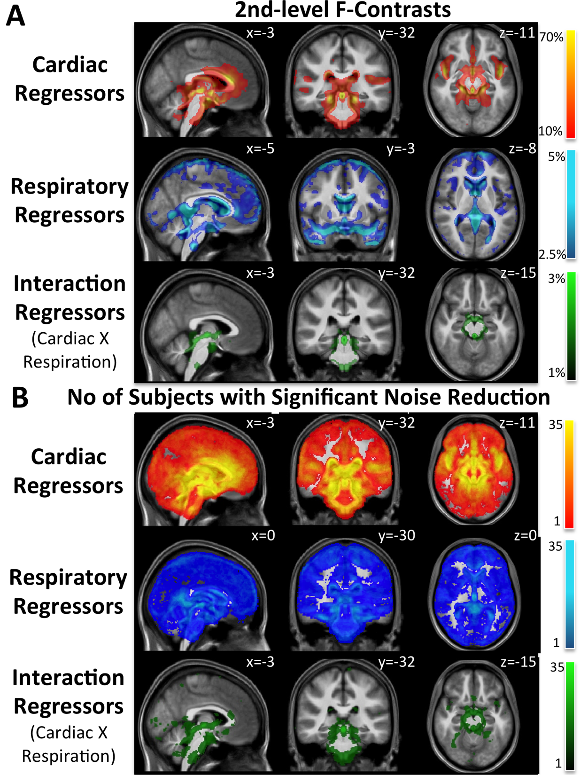
Group Level Impact PhysIO
Andreea Diaconescu (TNU): Social Learning Experiment 2012-2014

Slide 12
When? – PhysIO experience
Andreea Diaconescu (TNU): Social Learning
Higher sensitivity for group effects (N=35)
Prediction of advice reliability: dmPFC, bilateral FFA
Prediction error: dmPFC
Less false/ambiguous positives:
Brainstem (Substantia Nigra)

Slide 13
When? – PhysIO experience
Andreea Diaconescu (TNU): Social Learning
Higher sensitivity for group effects (N=35)
Prediction of advice reliability: dmPFC, bilateral FFA
Prediction error: dmPFC
Less false/ambiguous positives:
Brainstem (Substantia Nigra)

Slide 14
When? – PhysIO experience
Andreea Diaconescu (TNU): Social Learning
Higher sensitivity for group effects (N=35)
Prediction of advice reliability: dmPFC, bilateral FFA
Prediction error: dmPFC
Less false/ambiguous positives:
Brainstem (Substantia Nigra)

Slide 15
When? – PhysIO experience
Andreea Diaconescu (TNU): Social Learning
Higher sensitivity for group effects (N=35)
Prediction of advice reliability: dmPFC, bilateral FFA
Prediction error: dmPFC
Less false/ambiguous positives:
Brainstem (Substantia Nigra)

Slide 16
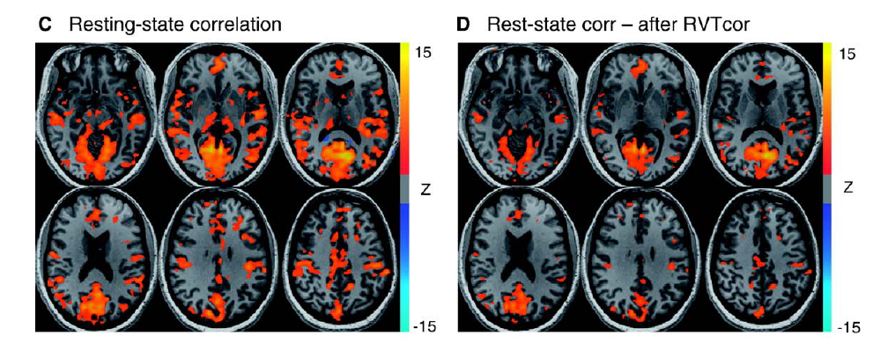
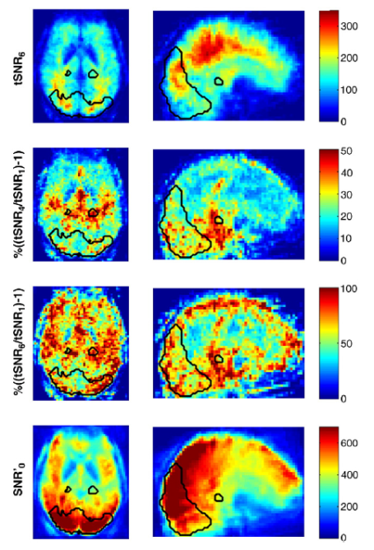
When? – Literature Evidence
Resting-state:
Birn, R. M. “The Role of Physiological Noise in Resting-state Functional Connectivity.” NeuroImage 62, 2012
Birn, R. M., et al. “Separating Respiratory-variation-related Fluctuations from Neuronal-activity-related Fluctuations in fMRI.” NeuroImage 31, 2006
Task-based:
Hutton, C., et al. “The Impact of Physiological Noise Correction on fMRI at 7 T.” NeuroImage 57, 2011:

Slide 17
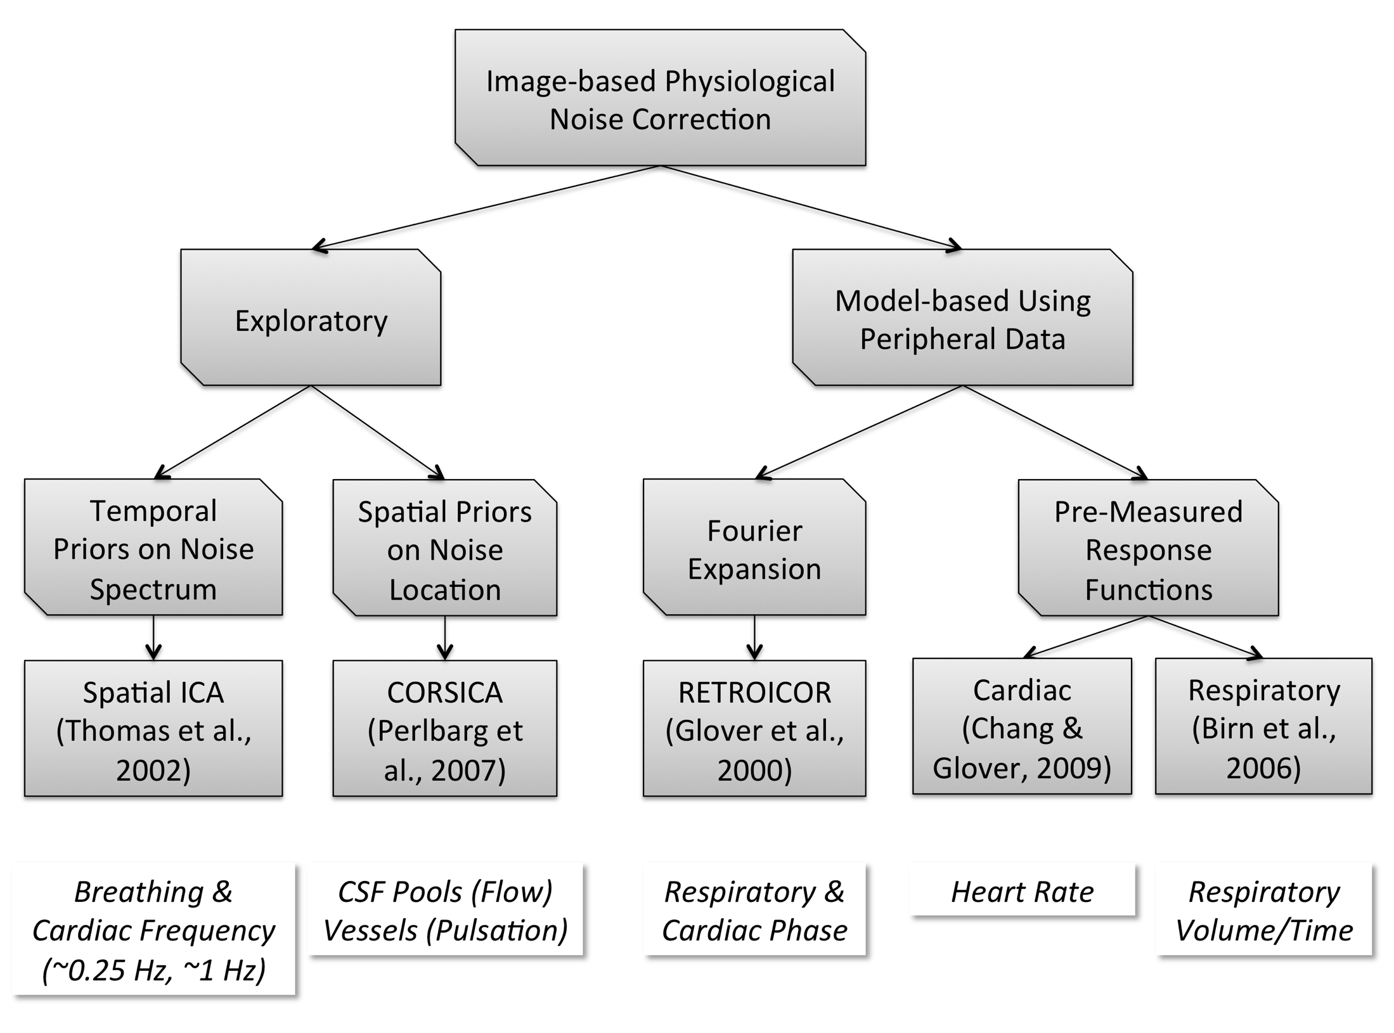
The Solution: Image-based Physiological Noise Correction
PhysIO Toolbox

Slide 18
Noise Modelling
RETROspective Image CORrection
Cardiac Response Function
Respiratory Response Function
Cardiac/respiratory phase
Heart Rate
Resp. Volume per Time
Fourier expansion (cosine/sine)
convolved with CRF
convolved with RRF
evaluated at 1 time point (slice) per volume = regressor

Slide 19
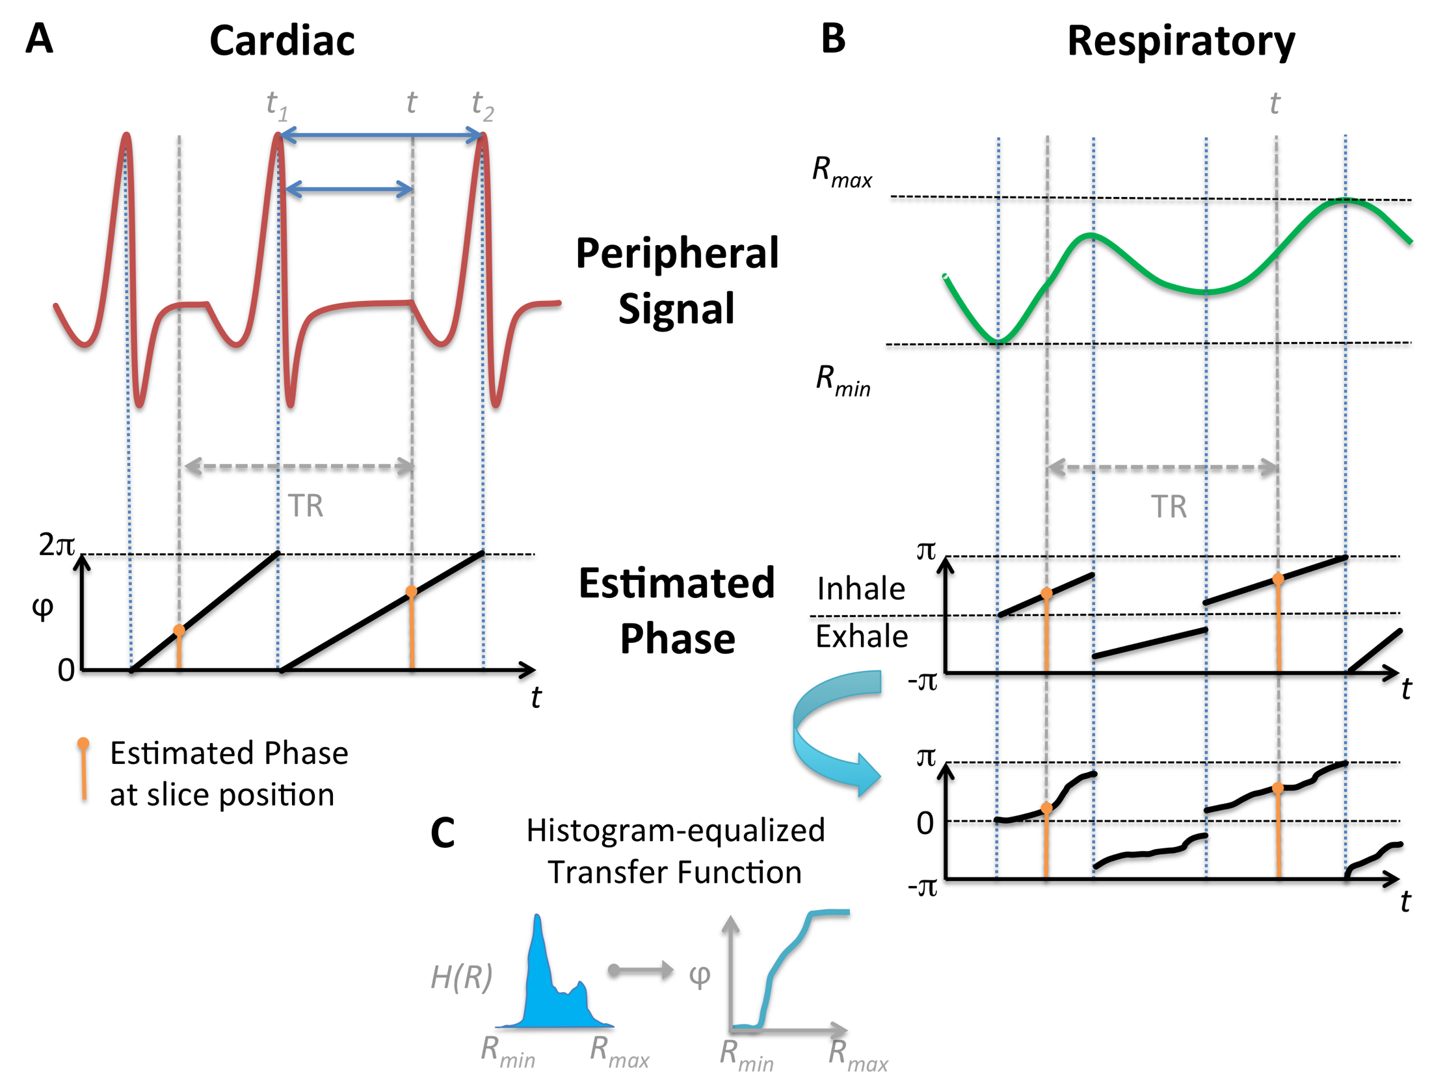
Noise Modelling
Cardiac/respiratory phase
RETROspective Image CORrection
Cardiac Response Function
Respiratory Response Function

Slide 20
Noise Modelling: Fourier Phase Expansion
cosine and sine to allow for constant phase shifts per voxel
higher model orders to account for under-sampling of physiological frequencies with typical TR in fMRI
cos φ
sin φ
cos 2φ
sin 2φ
cos 3φ
sin 3φ
scans

Slide 21
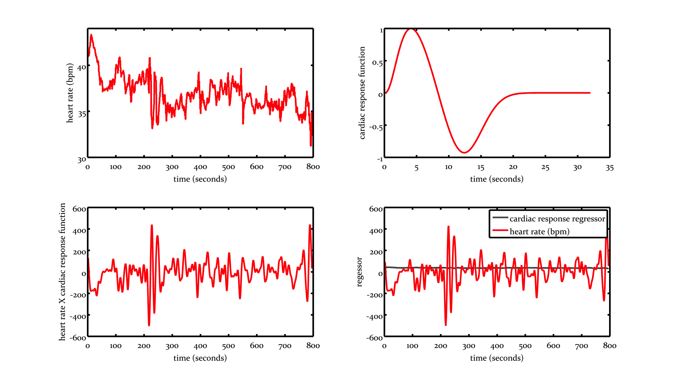
Noise Modelling
RETROspective Image CORrection
Cardiac Response Function
Respiratory Response Function
Heart Rate
Heart Rate Variability Response Regressor
convolved with CRF

Slide 22
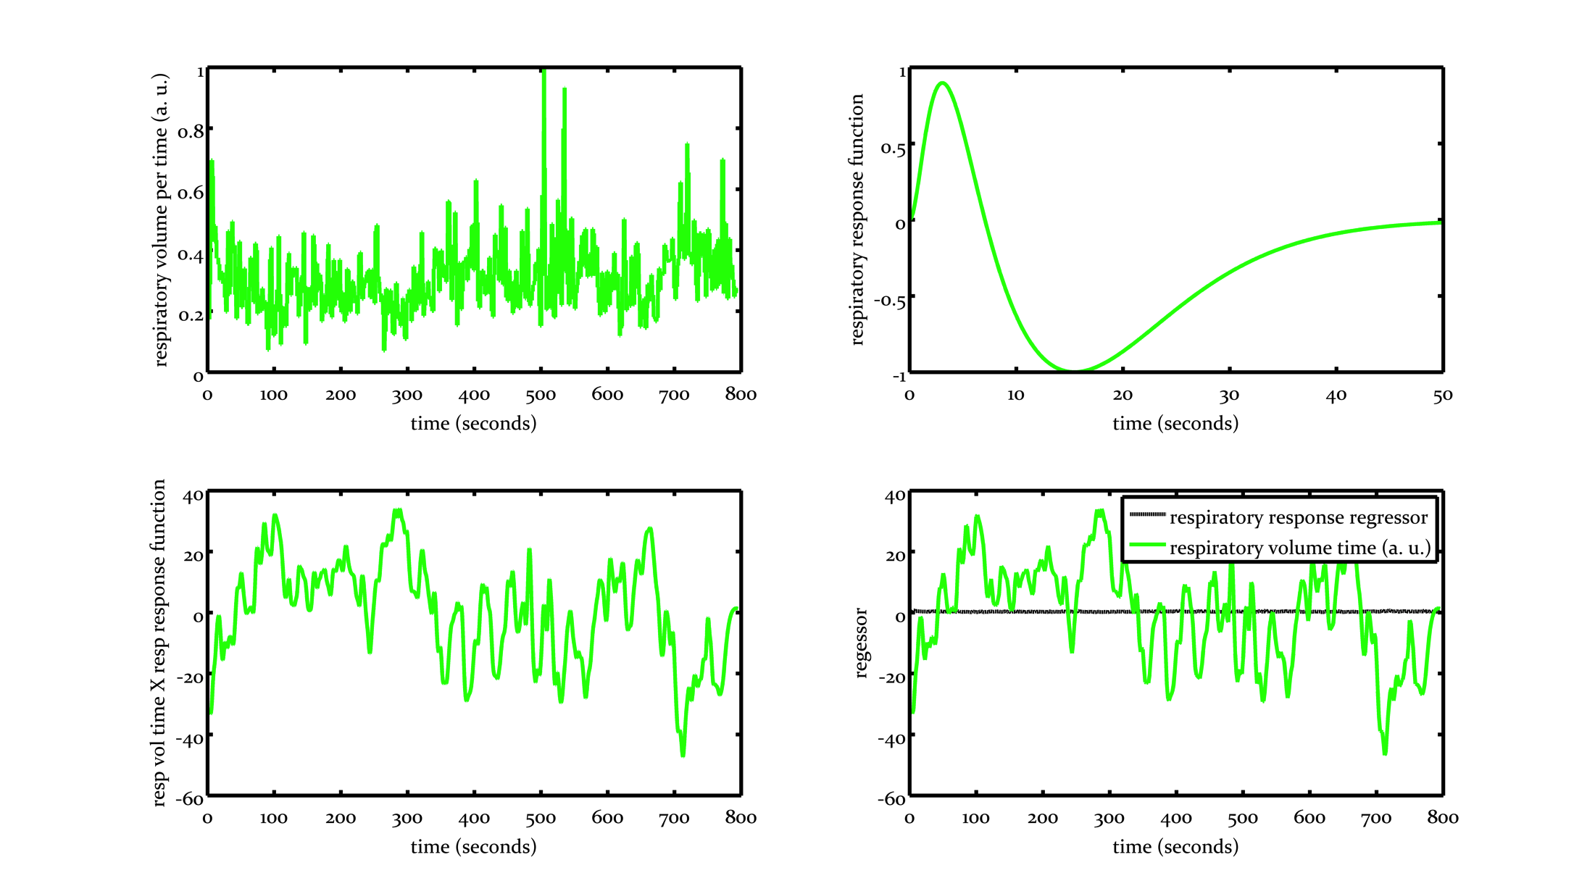
Noise Modelling
RETROspective Image CORrection
Cardiac Response Function
Respiratory Response Function
Respiratory Volume per Time
Respiratory Volume per Time Regressor
convolved with RRF

Slide 23
The Solution: Physiological Noise Correction
1. Physiological Monitoring
2. Preprocessing of Physiological Data
3. Model time series physiological noise
4. Noise Reduction and Assessment
Peripheral Devices
PhysIO Toolbox
SPM
ECG, PPU → Cardiac cycle
Breathing belt → Respiratory cycle
Confound regressors

Slide 24
Workflow PhysIO Toolbox
Read logfiles
Preprocess physiological data
Model time series physiological noise
Of peripheral physiological data
Vendor-specific
RETROICOR
Respiratory Volume
Heart Rate
Include confound regressors (GLM)
Filter noisy ECG & detect cardiac pulses
Hand-pick missing pulses
Multiple_regressors file for SPM
Check Influence of Physiological Noise (Correction) on Data
SPM
F-contrast on 1st and second level
Finally:

Slide 25
Workflow PhysIO Toolbox
Read logfiles
Preprocess physiological data
Model time series physiological noise
Include confound regressors (GLM)

Slide 26
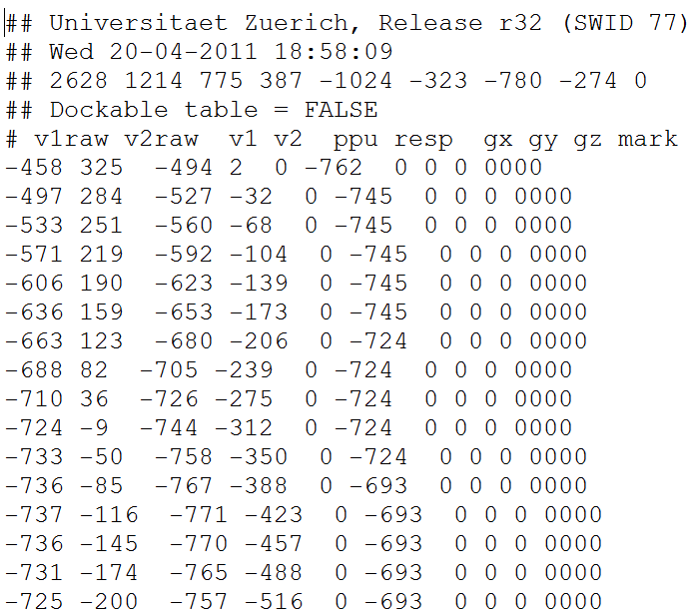
Workflow PhysIO Toolbox
Read logfiles
Preprocess physiological data
Model time series physiological noise
Include confound regressors (GLM)
SCANPHYSLOG.log
…
One line every 2 ms

Slide 27
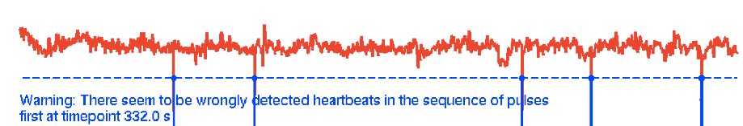
Workflow PhysIO Toolbox
Read logfiles
Preprocess physiological data
Model time series physiological noise
Include confound regressors (GLM)
Align scan timing to physiological time series
Misdetectedheartbeats
Notes:
TODO: better example w/ actually missed heartbeats

Slide 28
Workflow PhysIO Toolbox
Read logfiles
Preprocess physiological data
Model time series physiological noise
Include confound regressors (GLM)
Cardiac & respiratory phase estimation
Regressors via Fourier expansion of phases: RETROspective Image CORrection (RETROICOR)

Slide 29
Workflow PhysIO Toolbox
Read logfiles
Preprocess physiological data
Model time series physiological noise
Include confound regressors (GLM)

Slide 30
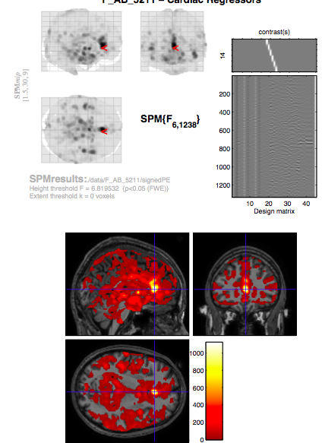
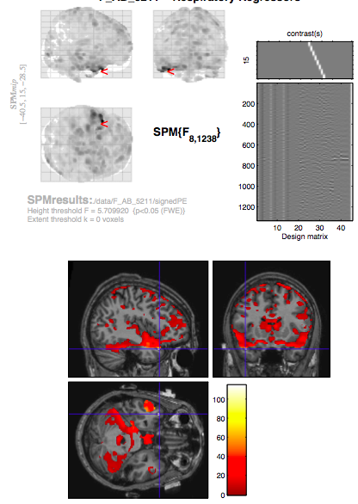
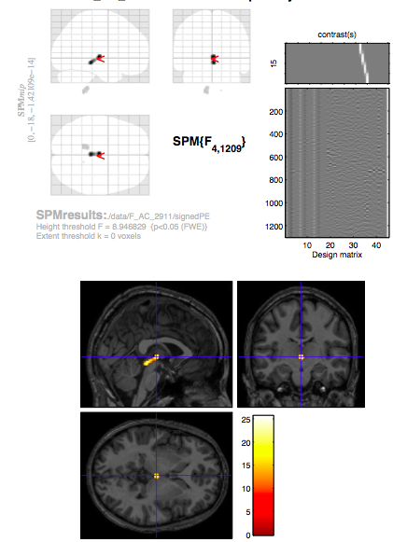
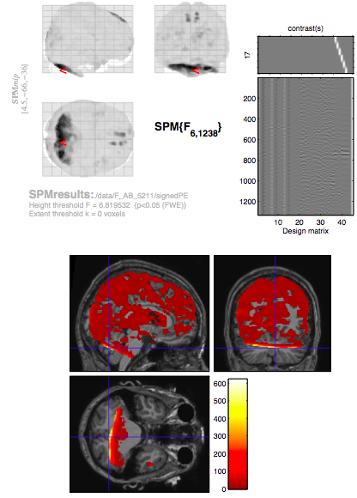
Model Check: SPM F-contrasts
Cardiac regressors
Respiratory regressors
Cardiac x Respiratory
Movement regressors
Check Influence of Physiological Noise (Correction) on Data
SPM
F-contrast on 1st and second level
Finally:

Slide 31
References
Birn, Rasmus M., Jason B. Diamond, Monica A. Smith, and Peter A. Bandettini. 2006. “Separating Respiratory-variation-related Fluctuations from Neuronal-activity-related Fluctuations in fMRI.” NeuroImage 31 (4) (July 15): 1536–1548. doi:10.1016/j.neuroimage.2006.02.048.
Glover, G H, T Q Li, and D Ress. 2000. “Image-based Method for Retrospective Correction of Physiological Motion Effects in fMRI: RETROICOR.” Magnetic Resonance in Medicine: Official Journal of the Society of Magnetic Resonance in Medicine / Society of Magnetic Resonance in Medicine 44 (1) (July): 162–7.
Harvey, Ann K., Kyle T.S. Pattinson, Jonathan C.W. Brooks, Stephen D. Mayhew, Mark Jenkinson, and Richard G. Wise. 2008. “Brainstem Functional Magnetic Resonance Imaging: Disentangling Signal from Physiological Noise.” Journal of Magnetic Resonance Imaging 28 (6): 1337–1344. doi:10.1002/jmri.21623.
Hutton, C., O. Josephs, J. Stadler, E. Featherstone, A. Reid, O. Speck, J. Bernarding, and N. Weiskopf. 2011. “The Impact of Physiological Noise Correction on fMRI at 7 T.” NeuroImage 57 (1) (July 1): 101–112. doi:10.1016/j.neuroimage.2011.04.018.
Josephs, O., Howseman, A.M., Friston, K., Turner, R., 1997. “Physiological noise modelling for multi-slice EPI fMRI using SPM.” Proceedings of the 5th Annual Meeting of ISMRM, Vancouver, Canada, p. 1682
Kasper, Lars, Sarah Marti, S. Johanna Vannesjö, Chloe Hutton, Ray Dolan, Nikolaus Weiskopf, Klaas Enno Stephan, and Klaas Paul Prüssmann. 2009. “Cardiac Artefact Correction for Human Brainstem fMRI at 7 Tesla.” In Proc. Org. Hum. Brain Mapping 15, 395. San Francisco.

